Slide 1
Next Gen Entity MDM D&B Update Consumption
Notes:
Need a business area slide

Slide 2
POV on D&B Update Process Consumption and Publish to Downstream
D&B Monitoring (Updates)
D&B Monitoring process allows us to keep a track of the changes being done on D&B for subscribed records.
Party Attributes that can be updated by the Monitoring process
Party Name
Address (All Addresses Physical, Postal and Legal)
Trade style Names
Tax Identifiers
D&B Attributes
Sales Volumes
Employee Counts
Ownership Types
SIC Codes/Industry Information
D&B Hierarchy
This is currently disabled in Production due to concerns raised by S4 (Finance)
Drivers for enabling D&B Monitoring/Updates
The D&B records on production are becoming out of sync and could contain stale information
Family Tree updates for any M&A changes and addition of new sites are missed. These updates will be required for Company Hierarchy to be up to date
D&B has also raised concerns about the backlog of updates to be processed which is taking up too much memory on their systems

Slide 3
POV on D&B Updates Consumption and Publish to Downstream
Volume of Changes
Assuming 2 M Parties records with a Party Role (After MDCP migration loads):
Name Changes – 65K D&B Updates per month
Address Change
Address Line – 74K D&B Updates per month
City – 37K D&B Updates per Month
Trade style Names – 13K D&B Updates per month
Tax Identifier – 181K D&B Updates per month
Need volume estimates for M&A –
Need % per type of change

Slide 4
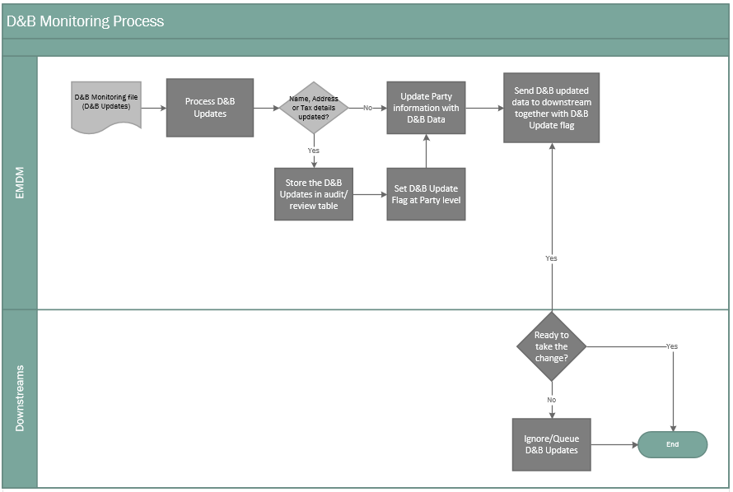
POV on D&B Update Process Consumption and Publish to Downstream
Recommended by Deloitte and D&B as industry standard
Notes:
Is this option creating discrepancies between Finance and OM? Can Finance implement a different consumption model while under the same S4 umbrella with OM, Deal Mgmt (that want to consume real time D&B updates)

Slide 5
Need real time D&B updates - confirmed
Need real time D&B updates – feedback collection WIP
D&B Updates: Publish to Downstream Systems
Real time D&B updates – may have negative impact
# | Attributes Group can be Published | Marketing | CRM/ Service Delivery | CPQ |  | OM | Supply Chain | Renewals | Procurement |  | Finance | SCO | BI
 |  |  |  | Quoting | Pricing
 |  | SFDC (2.2) | SFDC (2.2) | NGQ (2.2) | S4 (as soon as we turn D&B updates on) |  |  |  |  |  |  | SAPC (2.2) | EAP (2.1)
1 | Name (Org Name, and Alternate Names)
2 | Address (Address Line1, City, Post Code, Country, etc.)
3 | Tax Identifiers
4 | Merged Parties (as part of CLP Process or Manual Merges, or Auto Merges)
5 | D&B Sourced Other Attributes (IV, IS, D&B Hierarchy, etc.)
6 | Reference Data (Country, Languages, State/Province, etc.)
Notes:
Deal Mgmt is in S4 in 2.1
Involve CPQ Hybris

Slide 6
POV on D&B Updates Consumption and Publish to Downstream
Next Steps:
Reach agreement that D&B updates will be consumed by S4 - Mihaela and Lee to organize call with core group that will be defined
Whether D&B updates are needed in S4 at a different frequency than EMDM – work streams in S4 to align to a common S4 frequency strategy
Whether D&B updates need review prior to being consumed – work streams in S4 to align to a common strategy

Slide 7
BACKUP

Slide 8
D&B Enrichment & Consolidate POV
Step # | Process step for D&B alignment and Master Data Creation | Industry Standard | Being Performed at HPE
1 | Enforce governance at source to ensure clean data is entered at source
2 | Align Legacy records with D&B and accept only high confidence score D&B alignment
3 | Add controls to verify D&B alignment through process and stewardship
4 | Store both Legacy and D&B name and address and not overwrite source data
5 | Consolidate (match & merge) based on D&B alignment and added controls such as TAX ID
*
* Being implemented for Dec release

Slide 9

Party Updates and Consumption by Transactional Applications
Entity MDM ensures clean and consistent master data, reducing the risk on operational processes and enable balance of trade analysis
Ariba
Callidus Cloud
Other Operational Applications
Key considerations
SFDC
CPQ
S4
Each transactional application manages Entity master data based on open/active transaction dependencies
dynamically accept changes (e.g., SFDC, CPQ)
require a controlled process for changes (e.g., S4, Ariba, CallidusCloud)
Controlled process
Continue with old name/address until all open transactions are closed
Once transactions are closed update Name/Address
Data governance organization will drive controls and communication with BAU teams
No change to current business process/timing for Entity master data MADO
Entity MDM (EMDM)
Match-merge
Results
Match merge report
MADO communication
EAP (Balance of Trade analysis)

Slide 10
POV on DNB Monitoring Process Consumption and Publish to Downstream
Option 2
EMDM Ops Review to include
Validation of change from D&B
System readiness to accept the change
Check against Statutory sites
Verify with Customer/Vendor on the validity of change

Slide 11
POV on DNB Monitoring Process Consumption and Publish to Downstream
Comparison | Option 1 – No manual Master Data Review | Option 2 – With manual Master Data Review
Effort/resources involved | EMDM provides core changes notification/flag to downstreams Logic implemented at downstream logic to accept/reject D&B changes | Intensive Manual intervention from the EMDM Ops team
Error Susceptibility | D&B Updates, errors will be managed by downstream systems reporting Reactive process for handling errors | Less error due to manual checks in place before accepting the update More proactive
Master Data sync between downstream systems | EMDM in sync with D&B Can lead to discrepancy between EMDM and downstream systems Downstreams will own process to manage/catchup with the MDM discrepancies | EMDM can be out of sync with D&B if the Ops review does not accept the D&B changes

